Slide 1
CSE 2451 Variables
Zichen Zhang

Slide 2
Overview
Variable
Declaration
Identifiers & keywords
Initialization & constants
Types
Basic I/O functions
printf()
scanf()
Program layout
Header files
main() function
Customized functions

Slide 3
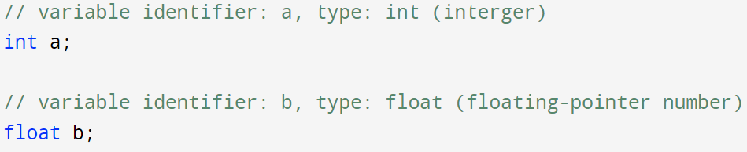
Variables - declaration
Variables
Named memory locations that we can use to store data
The storage area in a snippet of code where the program can easily manipulate (using the names we assign to the variable)
In C, we need to declare a variable with type and identifier before using the variable in the subsequent program
Variable starts to exist after its declaration (you can not use a variable before its existence)
Type: what type of data the variable is storing
Identifier: the name you assigned to the variable to distinguish itself with other variables
Each simple statement in C ends with “;”
Notes:
Variable classification:
https://byjus.com/gate/variables-in-c/#:~:text=Variable%20is%20basically%20nothing%20but,also%20reuse%20it%20multiple%20times.

Slide 4
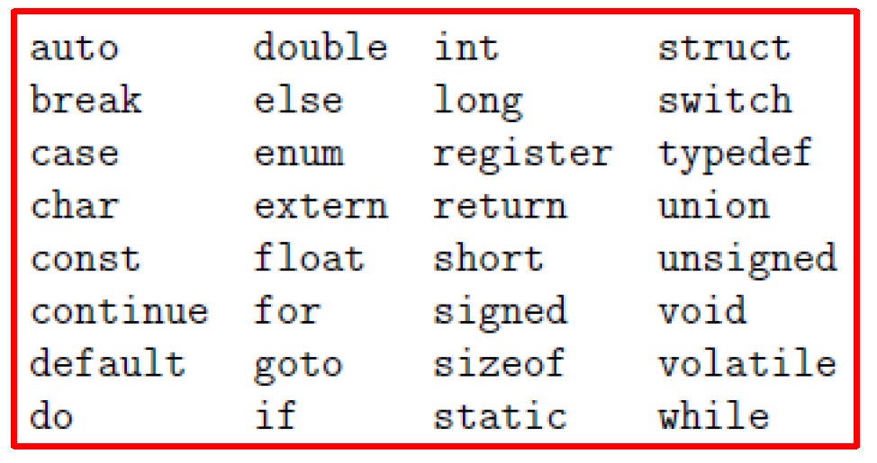
Variables - identifiers
Identifier is a combination of alphanumeric characters:
case sensitive: “int a;” and “int A;” are declaring two variables a and A. “Hello” and “hello” are different as well.
Combination of upper/lower case letters, numbers and underscores
The identifier must start with either a letter or an underscore “_”
Can’t use existing keywords for identifiers
Valid identifiers: “_a”, “_1”, “a1”, “a_1”
Invalid identifiers: “1a”, “1”, “?a”, “1_a”, “!a”
C keeps a small set of keywords for its own use
These keywords are part of the language itself
Don’t name your variable or customized function with these keywords (avoid name collision)
E.g., “Hello everyone, my name is name”

Slide 5
identifier test
identifiers | valid | invalid
int
Int
@hello
H ello
H_e_L_L_0
_4______4
_4____@3
A-3
M_n_Z_W_3
____4
_M_N_vv_234

Slide 6
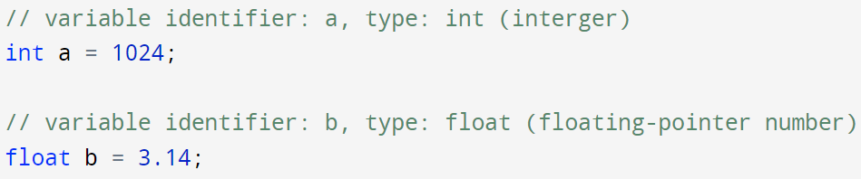
Variables - initialization
Initialization
A variable declared without initialization has random value stored in memory
We can initialize the variable with some value at the time of declaration
Constants/literals
The fixed values we assigned to our variables in initialization or assignment operations
1024 (1024 is constant integer)
3.14 (3.14 and 1024.0 are constant floating-point number)
Our program can change the value of variables a or b later, but can’t change the fixed initialization values 1024 or 3.14 that were hard-coded in the source file
Assignment operation

Slide 7
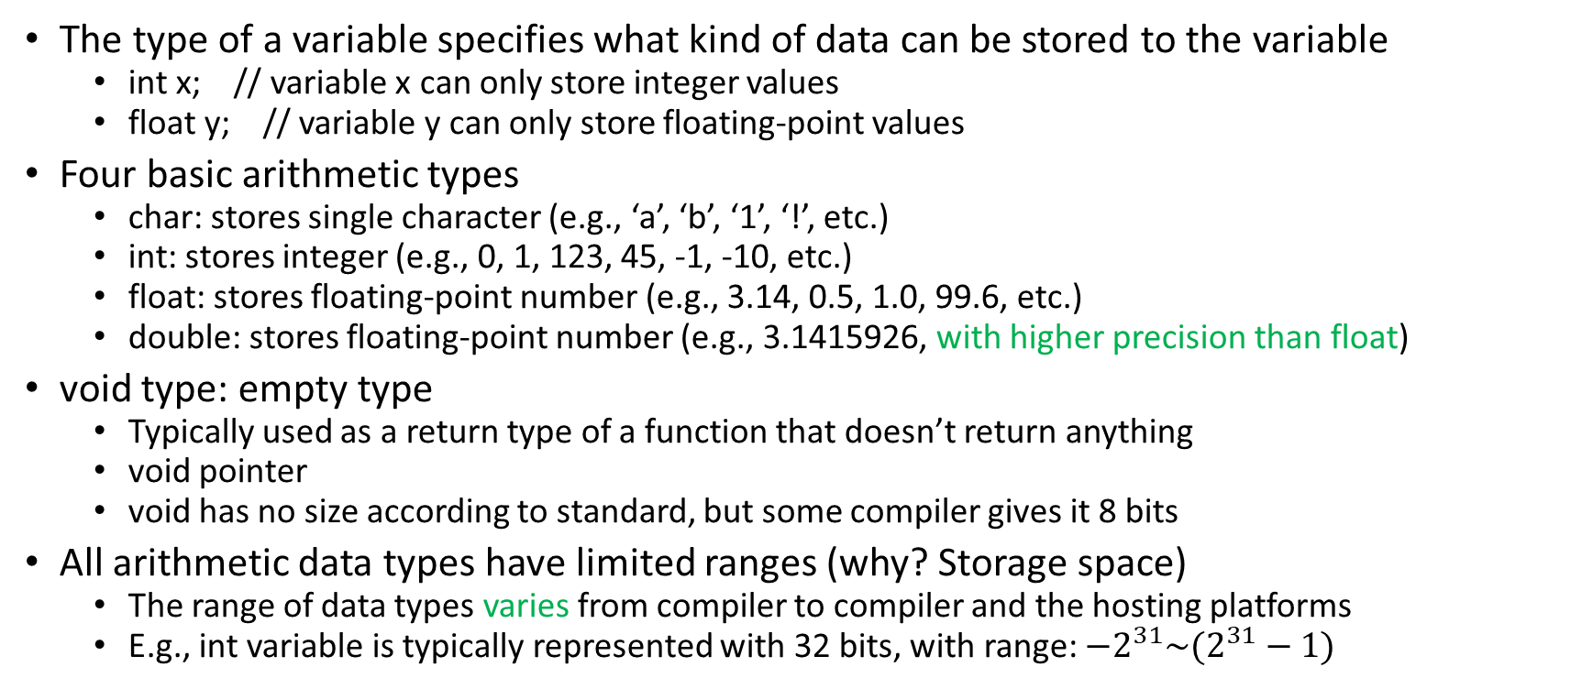
Variables - types
The type of a variable specifies what kind of data can be stored to the variable
int x; // variable x can only store integer values
float y; // variable y can only store floating-point values
Four basic arithmetic types
char: stores single character (e.g., ‘a’, ‘b’, ‘1’, ‘!’, etc.)
int: stores integer (e.g., 0, 1, 123, 45, -1, -10, etc.)
float: stores floating-point number (e.g., 3.14, 0.5, 1.0, 99.6, etc.)
double: stores floating-point number (e.g., 3.1415926, with higher precision than float)
void type: empty type
Typically used as a return type of a function that doesn’t return anything
void pointer
void has no size according to standard, but some compiler gives it 8 bits
All arithmetic data types have limited ranges (why? Storage space)
The range of data types varies from compiler to compiler and the hosting platforms
E.g., int variable is typically represented with 32 bits, with range: $−2^{31}\sim (2^{31}−1)$

Slide 8
Variables – type specifiers
Type specifiers in C: used to specify the range of arithmetic data types
signed:
used for signed integers, values can be both negative, 0, and positive
unsigned:
used for unsigned integers, all values are bound to be non-negative
short:
not used very often, its size <= its ordinal counter part
E.g., sizeof(short int) <= sizeof(int)
long:
used for integer or double, increasing the number of bits used to represent the associated values
long size of:
used for integer, increasing the number of bits used to represent the associated values
Notes:
Reference:
http://doafco.com/wp/2019/09/06/what-is-modifier-in-c-and-different-types-of-modifiers/#:~:text=There%20are%20two%20types%20of,Sign%20modifiers%20%E2%80%93%20signed%2C%20unsigned

Slide 9
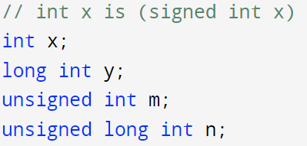




Variables – int type
Integer type: int
int have limited range (usually represented with 32 bits)
we can use type specifiers to change the range of types
typical range
$−2^{31} \sim {(2}^{31}−1)$, with 32 bits
$−2^{63}\sim {(2}^{63}−1)$, with 64 bits
$0 \sim 2^{32}−1$, with 32 bits
$0 \sim 2^{64}−1$, with 64 bits
Notes:
Some reference:
https://www.geeksforgeeks.org/data-types-in-c/
https://www.freecodecamp.org/news/data-types-in-c-integer-floating-point-and-void-explained/#:~:text=The%20long%20data%20type%20stores,range%20of%200%20to%204%2C294%2C967%2C295.
https://www.techcrashcourse.com/2015/11/modifiers-in-c-constants-data-types-c.html

Slide 10
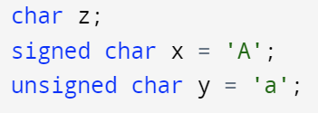
Variables – char type
Character type: char
char is in essence an integer type (usually represented with 8 bits)
Maps a number between 0 ~ 255 (unsigned char) or -128 ~ 127 (signed char) to the associated character specified by ASCII table
Common characters’ ASCII values are fixed in the range from 0 ~ 127
ASCII table
Pronounced as “ask ee”
“American Standard Code for Information Interchange”, standardized by American National Standards Institute
print x’s value as if it’s an integer, you get its ASCII value: 65
print y’s value as if it’s an integer, you get its ASCII value: 97

Slide 11
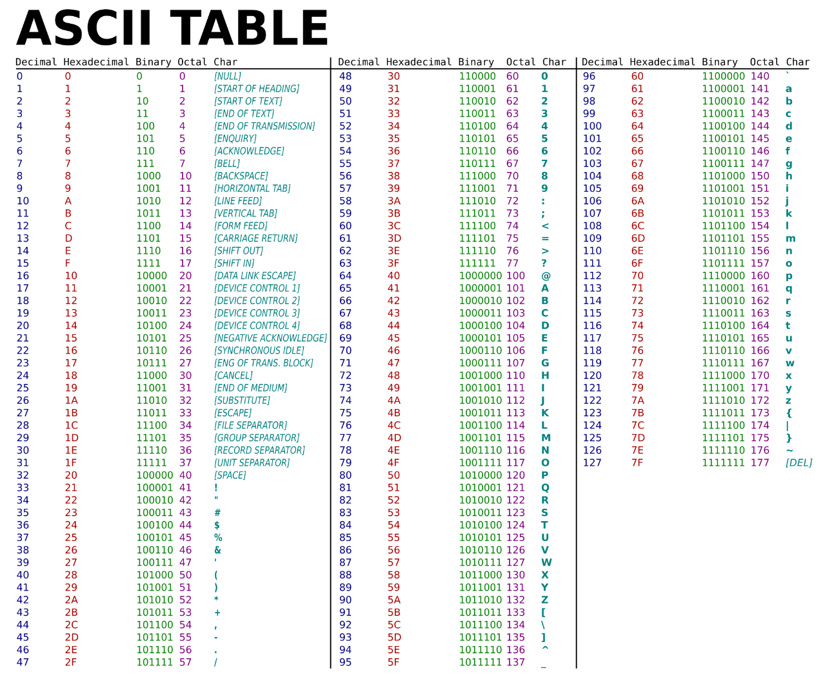
Variables – char type
char b = ‘a’;
printf(“%c”, b);
printf(“%d”, b);
int b = 97;
printf(“%c”, b);

Slide 12

Variables – floating-point types
For real numbers with fractional parts, we have 2 types:
float (usually 32 bits) → means single precision
double (usually 64 bits) → means double precision
Floating-point types have limited precision, double has higher precision than float
Always use double instead of float unless memory usage is critical and precision requirement is not high
x = 0.30000001192092896
y = 0.30000000000000004
wikipedia page on c data types
Notes:
floating-point number:
http://steve.hollasch.net/cgindex/coding/ieeefloat.html

Slide 13
Basic Input/Output functions
Input:
The user feeds some data to the program, either from the terminal via typing or in the form of a file via redirecting command (e.g., prog < data.txt)
Direction: User to program via some medium (e.g., keyboard, file)
Output
The program delivers some data to the user via the screen, printer or a file
Direction: Program to user via some medium (e.g., screen, printer, file)
Print data in terminal from your program
printf(), standard library function provided by stdio.h
Input data in terminal to your program
scanf(), standard library function provided by stdio.h

Slide 14
Basic Input/Output functions
A function is a group of statements that are encapsuled together to perform a task
e.g., mean(list) function, compute the mean of numbers in the input list
e.g., std(list) function, compute the standard deviation of numbers in the input list
C provide standard library which implemented a collection of utility functions for us to use
<stdio.h>
<math.h>
…
Print data to terminal from your program
printf(), standard library function provided by stdio.h
prints message from the program to the terminal
Input data to your program from the terminal
scanf(), standard library function provided by stdio.h
Scans user input from keyboard to the program
Notes:
https://en.wikipedia.org/wiki/C_standard_library

Slide 15

Basic Input/Output functions – printf()
int printf(const char * format, …)
Writes the string specified by format and other arguments listed in “…” to terminal/screen (could have 0, 1 or more arguments)
return an integer value, which is the total number of printed characters
int x = 10;
double y = 1.5;
printf(“hello world!\n”);
printf(“x = %d\n”, x);
printf(“x is %d, y is %lf\n”, x, y);
Format: “hello world!\n”, no arguments
Display in terminal
Format: “x = %d\n”, one argument x
Format: “x is %d, y is %lf\n”, two arguments x and y

Slide 16
Basic Input/Output functions – printf()
int printf(const char * format, …)
format includes:
Common character, e.g., “hello world!”, “x = ”, “x is”, “y is ”, print as-is in terminal
Conversion character, e.g., “%d”, “%lf”, placeholder for real values of input arguments in “…”
Escape sequence, “\n”, print a newline
int x = 10;
double y = 1.5;
printf(“hello world!\n”);
printf(“x = %d\n”, x);
printf(“x is %d, y is %lf\n”, x, y);
Format: “hello world!\n”, no arguments
Display in terminal
Format: “x = %d\n”, one argument x
Format: “x is %d, y is %lf\n”, two arguments x and y

Slide 17
Basic Input/Output functions – scanf()
int scanf(const char * format, …)
Read from user keyboard input, and scans the values according to the format provided, “…” is the list of addresses of arguments used to store the scanned input values (could have 1 or more addresses)
return an integer value, which is the number of input arguments successfully extracted from user input
double x, y;
scanf(“%lf, %lf”, &x, &y);
printf(“x is %lf, y is %lf\n”, x, y);
User input in terminal after the program is executed:
3.14,<space>5.12<enter>
Terminal display:
x is 3.140000, y is 5.120000

Slide 18
Basic Input/Output functions – conversion character
Conversion characters are typically used in the format input argument, starting with a % character followed by some alphabetic character(s):
For printf() function, as the placeholders for the real values in the “…” argument lists
printf(“number of students is %d in CSE %d\n”, 25, 2451);
Terminal: number of students is 25 in CSE 2451
For scanf() function, as the placeholders to specify the user input format
scanf(“%d, %d”, &count, &class_number);
User input: 25, 2451
Value of count = 25, value of class_number = 2451
User input: 25, 3.14
Values of count = 25, value of class_number = ?
The associated real values should match their conversion characters, otherwise will cause errors (e.g., wrong values being printed/scanned)
Conversion character | Type
%c | single character, e.g., char x = ‘a’;
%d | Signed decimal integer, e.g., int x = 30;
%i | Signed decimal integer (int)
%u | Unsigned decimal integer
%o | Unsigned octal (base 8) integer
%x | Unsigned hexadecimal (base 16) integer
%f | Signed floating-point value (float)
%lf | Signed floating-point value (double)
%e | Signed floating-point value in scientific notation (31.4 = 3.14000e+01)
%s | String of text
%% | Print a % symbol, e.g., printf(“percent %%”) -> print one % symbol in terminal
Notes:
class_number = 3

Slide 19
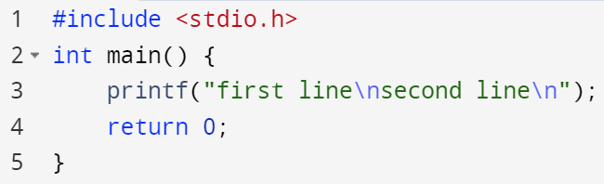

Basic Input/Output functions – escape sequence
An escape sequence is a combination of characters that has a meaning other than the literal characters contained therein
Starts with a backslash ‘\’
‘\n’ -> a newline, printf(“first line\nsecond line\n”)
‘\t’ -> horizontal tab (~= 4 spaces)
‘\\’ -> a single backslash \
‘\’’ -> a single quote ’
‘\”’ -> a double quote ”
‘\%’ -> a percent character %

Slide 20
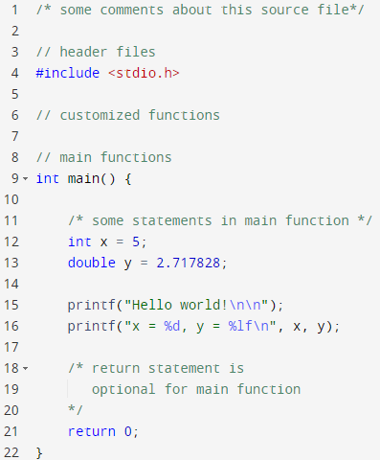

Basic Program Layout
Header files
Header file corresponding to standard library functions used in source code
Standard library can be included via “#include <HeaderFileName.h>”
Header file corresponding to source file of your customized functions
One program (file) can have multi header files
Main function
Entry point of a program
One program must have one and only one main function

Slide 21
Demo
Source file: demo.c
Use Ubuntu (Linux) Virtual Machine
Use VS code
Use terminal and gcc command:
gcc demo.c –o myprogram –std=c99
Quick C online compiler:
Quick verify of simple code snippet
Click Run instead of using commands
Link is here

